Slide 1


JSPM’s Rajarshi Shahu College of Engineering, Tathawade, Pune – 33 (An Autonomous Institute affiliated to Savitribai Phule Pune University) department of electrical engineering
Name of students :- 1. Prathmesh Titre (EL2156)
2. Nirbhay Meshram (EL2133)
3. Varun Salpe (EL2144)
4. Rajratna Wasnik (EL2139)
S.Y. B.Tech
Academic Year : 2020-2021
Sem - 3
Name of Facilitator :- Dr. Trupti Hinge
Project - Automatic room light controller using IR sensor.

Slide 2
List of content
1) INTRODUCTION
2) ABSTRACT
3) WORKING
4) CIRCUIT DIAGRAM
5) COMPONENTS
6) CONCLUSION

Slide 3
Introduction
In this project, we will see the Automatic Room Lights using Arduino and PIR Sensor, where the lights in the room will automatically turn ON and OFF by detecting the presence of a human.
Such Automatic Room Lights can be implemented in your garages, staircases, bathrooms, etc. where we do not need continuous light but only when we are present.
Also, with the help of an automatic room light control system, you need not worry about electricity as the lights get automatically off when there is no person.
So, in this DIY project, we have implemented Automatic Room Lights using Arduino and PIR Sensor.

Slide 4
Abstract
Automatic Room Lights System using Arduino is a very useful project as you need not worry about turning on and off the switches every time you want to turn on the lights. The main components of the Automatic Room Lights project are Arduino, PIR Sensor and the Relay Module.
Out of the three components, the PIR Sensor is the one in focus as it is the main device that helps in detecting humans and human motion.
In fact, the Automatic Room Lights project can be considered as one major application of the PIR Sensor. A similar concept is being already implemented in automatic toilet flush valves, hand dryers, etc.

Slide 5
Working of project
The Automatic Room Lights using Arduino and PIR Sensor is a simple project, where the lights in the room will automatically turn on upon detecting a human motion and stay turned on until the person has left or there is no motion.
Working of this project is very simple..
Initially, when there is no human movement, the PIR Sensor doesn’t detect any person and its OUT pin stays LOW. As the person enters the room, the change in infrared radiation in the room is detected by the PIR Sensor.
As a result, the output of the PIR Sensor becomes HIGH. Since the Data OUT of the PIR Sensor is connected to Digital Pin 8 of Arduino, whenever it becomes HIGH, Arduino will activate the relay by making the relay pin LOW (as the relay module is an active LOW module).

Slide 6
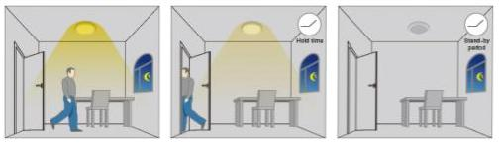
Since the Data OUT of the PIR Sensor is connected to Digital Pin 8 of Arduino, whenever it becomes HIGH, Arduino will activate the relay by making the relay pin LOW (as the relay module is an active LOW module).
This will turn the Light ON. The light stays turned ON as long as there is movement in front of the sensor.
If the person takes a nap or leaves the room, the IR Radiation will become stable (there will be no change) and hence, the Data OUT of the PIR Sensor will become LOW. This in turn will make the Arduino to turn OFF the relay (make the relay pin HIGH) and the room light will be turned OFF.

Slide 7
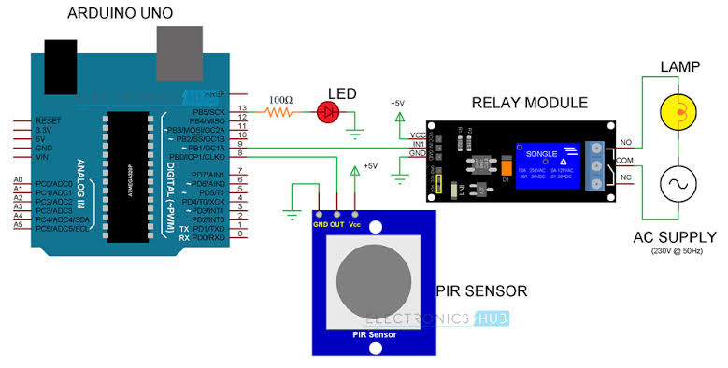
Circuit Diagram of Automatic Room Lights using Arduino
The following image shows the circuit diagram of the project implemented using Arduino UNO, PIR Sensor and a Relay Module.

Slide 8
Components required
Sr.No | Component | Quantity
1 | Arduino UNO | 1
2 | PIR Sensor | 1
3 | 5V Relay Module (Relay Board) | 1
4 | LED / BULB | 1
5 | 100Ω Resistor (1/4 Watt) | 1
6 | Connecting Wires | 1
7 | Breadboard | 1
8 | Power Supply / Battery 9v | 1

Slide 9
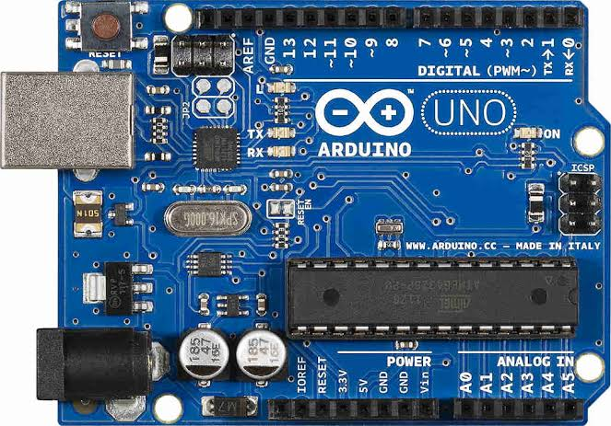
Arduino UNO
The Arduino Uno is an open-source microcontroller board based on the Microchip ATmega328P microcontroller and developed by Arduino.cc. The board is equipped with sets of digital and analog input/output pins that may be interfaced to various expansion boards and other circuits.

Slide 10
Code
int in1 = 9;
 | int sensor = 8;
 | int led = 13;
 | unsigned long t=0;
 | void setup()
 | {
 | Serial.begin(9600);
 | pinMode(in1, OUTPUT);
 | pinMode(sensor, INPUT);
 | pinMode(led, OUTPUT);
 | digitalWrite(in1,HIGH);
 | digitalWrite(led,LOW);
 | while(millis()<13000)
 | {
 | digitalWrite(led,HIGH);
 | delay(50);
 | digitalWrite(led,LOW);
 | delay(50);
 | }
 | digitalWrite(led,LOW);
 | }
 | void loop()
 | {
 | digitalWrite(in1,HIGH);
 | digitalWrite(led,LOW);
 | if(digitalRead(sensor)==HIGH)
 | {
 | t=millis();
 | while(millis()<(t+5000))
 | {
 | digitalWrite(in1,LOW);
 | digitalWrite(led,HIGH);
 | if((millis()>(t+2300))&&(digitalRead(sensor)==HIGH))
 | {
 | t=millis();
 | }
 | }
 | }
 | }
👈The code for the Automatic Room Lights using Arduino and PIR Sensor

Slide 11
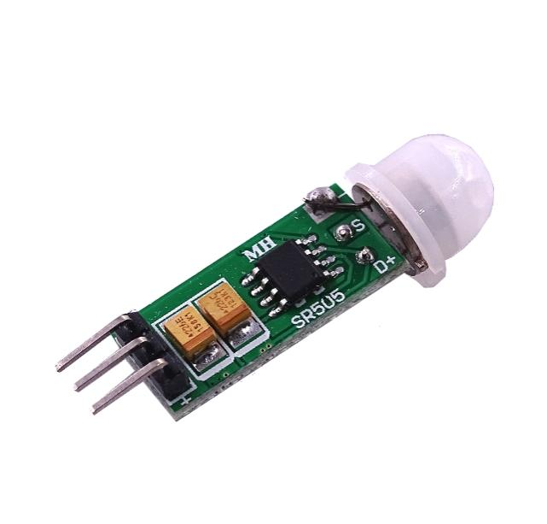
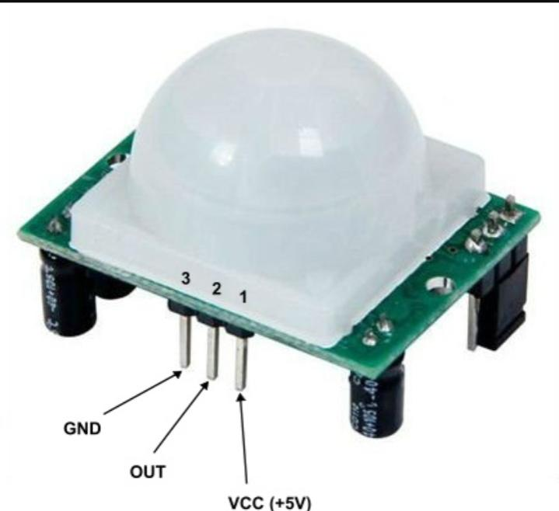
PIR Sensor
A passive infrared sensor (PIR sensor) is an electronic Sensor that measures infrared (IR) light radiating from objects in its field of view. They are most often used in PIR-based motion detector.
PIR sensors are commonly used in security alarms and automatic lighting applications.
PIR sensors allow you to sense motion. They are small, inexpensive, low-power, easy to use.

Slide 12
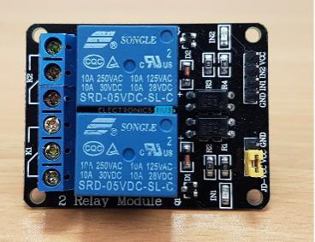
Relay Module
2-Channel 5V Relay Module is a relay interface board, it can be controlled directly by a wide range of microcontrollers such as Arduino, AVR, PIC, ARM and so on.
It is frequently used in an automatic control circuit. To put it simply, it is an automatic switch to control a high-current circuit with a low-current signal.
A Relay Module is a very useful component as it allows Arduino, Raspberry Pi or other Microcontrollers to control big electrical loads. We have used a 2-channel Relay Module in this project but used only one relay in it.

Slide 13
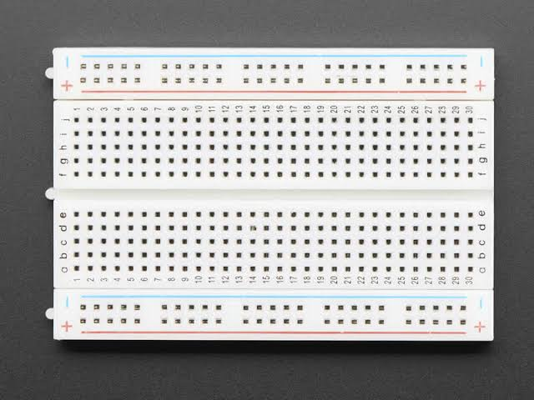
Breadboard
The Breadboard does not require soldering. It is reusable. This makes it easy to use for creating temporary prototypes and experimenting with circuit design. For this reason, solderless Breadboards are also extremely popular with students and in technological education.
A variety of electronic systems may be prototyped by using Breadboards, from small analog and digital circuits to complete Central Processing Units (CPUs)

Slide 14
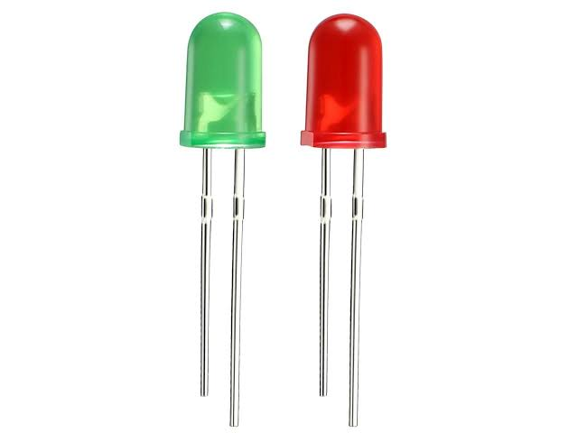
LED / Bulb
A Light Emitting Diode (LED) is a two-lead
semiconductor light source. It is a p-n junction diode that emits light when activated.

Slide 15
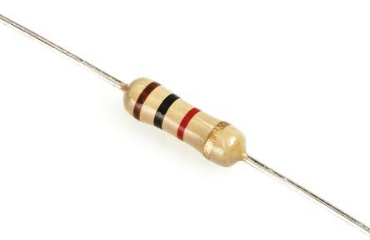
Resistor
A Resistor is a passive two-terminal electrical component that
implements electrical resistance as a circuit element. In electronic
circuits, Resistors are used to reduce current flow, adjust signal levels,
to divide voltages, bias active elements, and terminate transmission
lines, among other uses. High-power Resistors that can dissipate many watts of electrical power as a heat, may be used as a part of motor controls, in Power Distribution Systems, or as test loads for generators.

Slide 16
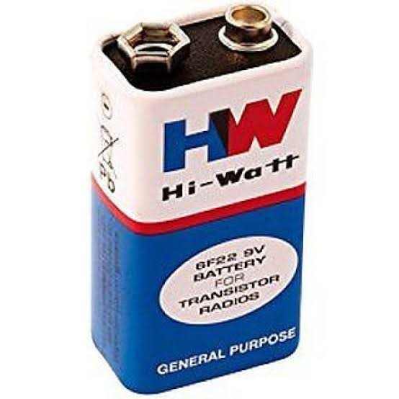
Battery
An electric battery is a device
consisting of one or more electrochemical
cells with an external connections provided
to power electrical devices such as smart-phone, torch lights, electric cars, etc.

Slide 17
Sr.No | Component | Quantity | Price
1 | Arduino UNO | 1 | 384
2 | PIR Sensor | 1 | 64
3 | 5V Relay Module (Relay Board) | 1 | 79
4 | LED / BULB | 1 | 5
5 | 100Ω Resistor (1/4 Watt) | 1 | 5
6 | Connecting Wires | 1 | 30
7 | Breadboard | 1 | 140
8 | Power Supply / Battery 9v | 1 | 120
 |  | Total - 8 | Total Estimated price - 827

Slide 18

Advantages
The main advantage of this project is that it helps in energy conservation. Because when there is nobody inside the room then lights are automatically turned off.
Reduce human efforts.
Save Electricity

Slide 19
ApplicationS
Garage Lights
Bathroom Lights
Hand Dryers
Toilet Flushers
Security Lights

Slide 20
Conclusion
Now a day huge amount of power is misused in daily life just for the reason that of human trend of presence lethargic. From the survey it is known that 1 unit of power protected is equal to the 1 unit of power manufactured. So this misused energy can be preserved and can be contribute to large amount of saving of power using automatic room light control system.
In the proposed system first detection of human being entering in the room can be done through already existing Ultrasonic sensor but its cost is very high as compare to the PIR sensors. The total effective cost of proposed system is very low as compare to existing system for Home and Offices.

Slide 21
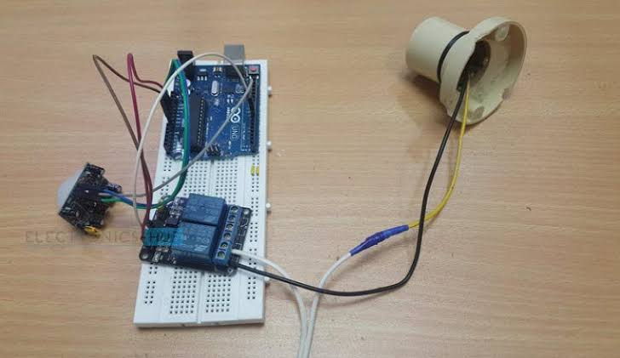
Model / prototype

Slide 22


